Slide 1
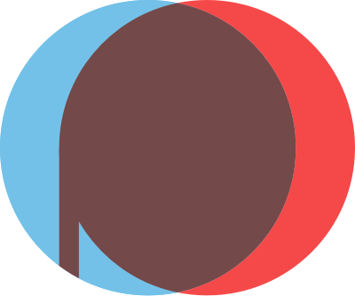

OpenProcessing

Slide 2
Introduction
OpenProcessing is a social coding platform to teach real-life coding:
An open educational platform.
Developers can find the best assignment ideas and teaching methods by browsing past classes that used OpenProcessing in the classroom.

Slide 3
Overview
OpenProcessing is an online platform that provides a creative space for artists, and programmers to share and collaborate on visual projects created with the Processing programming language, a software sketchbook and a programming language for learning how to code within the context of visual arts.
On OpenProcessing, users can create and share interactive sketches, animations, and other visual projects. The platform allows individuals to explore code, share their work, and engage with a community interested in creative coding and visual arts.
We can use simple JavaScript code to create all manner of beautiful art, interactive apps, and fascinating graphics (not to mention playing sounds, using video from webcams, and reading inputs from sensors like accelerometers).

Slide 4

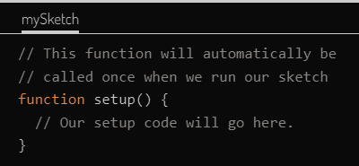
The setup Function
The setup function is a specially named function that p5js will call for us when the sketch first starts.
Every p5js sketch needs a setup function. But what is a function, you might ask? A function is a way to group together a series of JavaScript statements and give them a name. You can create your own functions that you will call later, which is a convenient way to reuse the same lines of code without typing them repeatedly in different places. But in the case of the setup function, this is a specially named function that p5js will call for us when the sketch first starts.
A function in JavaScript is made of the following parts:
The function keyword
The name of the function (must start with a letter, and contain only letters, numbers, and underscores).
A list of parameters enclosed in parentheses.
The parentheses are required even if there are no parameters.
The body of the function:
Starts with an open curly brace {
Followed by a series of statements.
These statements will be executed each time the function is called.
Ends with a closing curly brace }

Slide 5
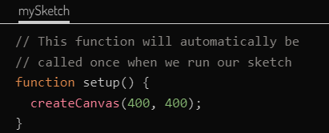
The createCanvas Function
The most important thing that happens in the setup function is the creation of our canvas, which is where our graphics will be displayed.
The createCanvas function takes two parameters*: the width of the canvas, and the height of the canvas. For starters we will create a canvas that is 400 pixels square.
Creates a canvas element in the document and sets its dimensions in pixels. This method should be called only once at the start of setup(). Calling createCanvas more than once in a sketch will result in very unpredictable behaviour. If you want more than one drawing canvas you could use createGraphics() (hidden by default but it can be shown).

Slide 6
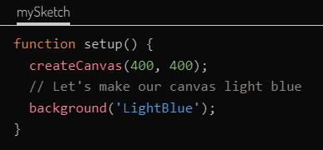

The Background Function
Named Colours
Certain colours can be specified using a text value that specified the name of the colour. A text value in JavaScript, also called a string, is a series of characters enclosed in either 'single' or "double" quotes*.
background('LightBlue’);
Shades of Gray
Shades of gray can also be specified with a single integer value from 0 to 255 where 0 is black and 255 is white.
// fill the canvas 50% gray
background(127);
RGB Values
Colours can also be specified using three numbers representing the amount of the three primary colours: red, green, and blue.
// the red green and blue values for light blue
background(173, 216, 230);
Hex Codes
To use this notation with p5js you would use a string value starting with a pound sign (#) followed by either 3 or 6 digits (i.e. '#add8e6'). However, this is the least readable way to represent a colour.
background('#00f526');
The background function will fill the canvas with a colour. There are several ways to specify what colour to use.

Slide 7
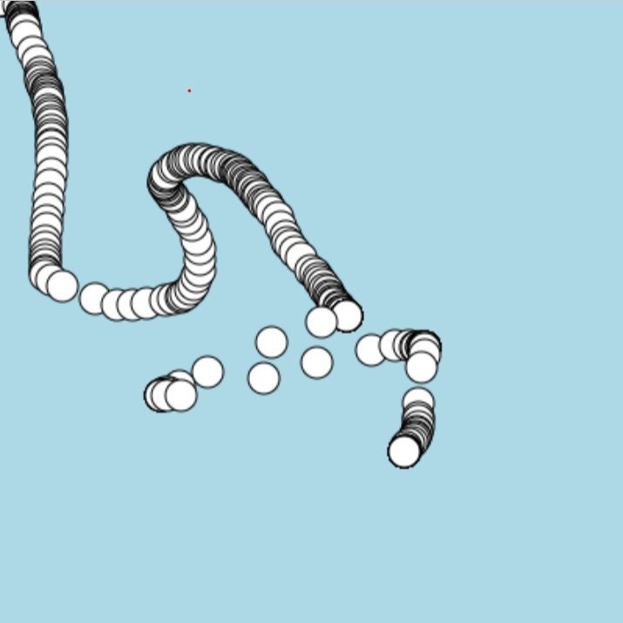
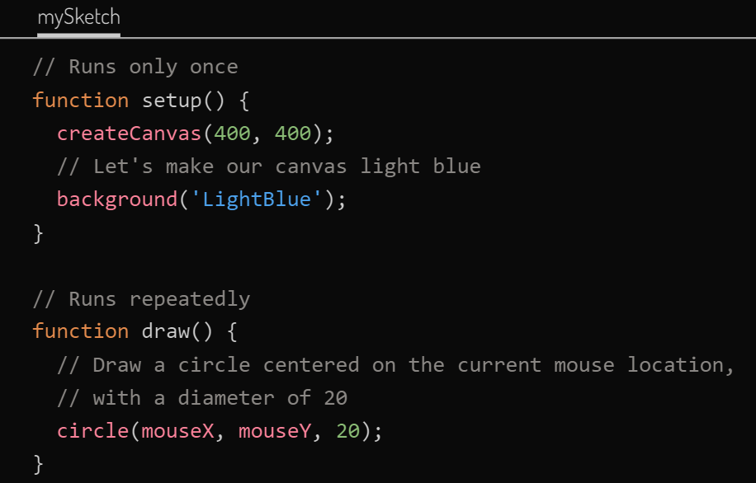
The Draw Function
The background function will fill the canvas with a colour. There are several ways to specify what colour to use.
In theory we could put all our drawing statements in the setup function. However, the setup function will only run once, and so it would on work for a static, non-interactive sketch.
The draw function is automatically called repeatedly so your sketch can change either over time, or in response to user interaction (clicking, mouse movement, etc.).
In this example every time the draw function is called it draws a circle wherever the mouse is currently positioned.
Notice that because we only fill the canvas with a solid colour in the setup function (by calling background), all the circles that we draw persist.

Slide 8
The Draw Function
The background function will fill the canvas with a colour. There are several ways to specify what colour to use.
In theory we could put all our drawing statements in the setup function. However, the setup function will only run once, and so it would on work for a static, non-interactive sketch.
The draw function is automatically called repeatedly so your sketch can change either over time, or in response to user interaction (clicking, mouse movement, etc.).
In this example every time the draw function is called it draws a circle wherever the mouse is currently positioned.
Notice that because we only fill the canvas with a solid colour in the setup function (by calling background), all the circles that we draw persist.

Slide 9
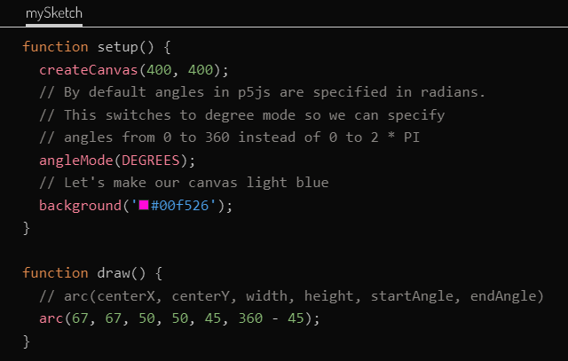

Drawing Shapes
P5js includes many different built in functions for drawing basic shapes:
arc - Draws a segment of a circle.
circle - Draws a circle.
ellipse - Draws an ellipse (like a circle, but with varying width and height).
line - Draws a single line segment from one point to another.
point - Draws a single point.
quad - Draws an arbitrary four sided shape connecting four points.
rect - Draws a rectangle.
square - Draws a square.
triangle - Draws a three sided shape connecting three points.

Slide 10
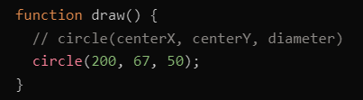

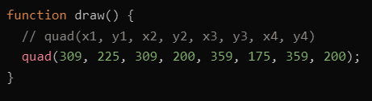
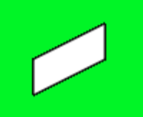
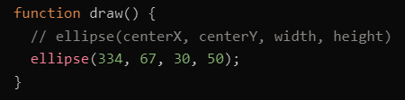

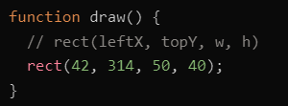
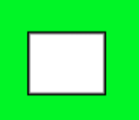
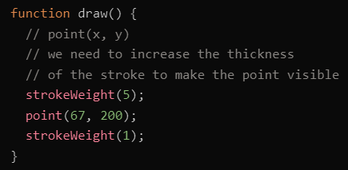
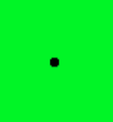
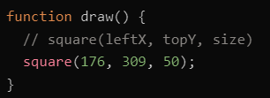

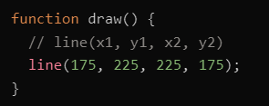

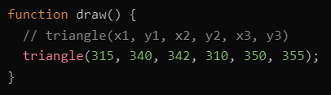

Drawing Shapes

Slide 11
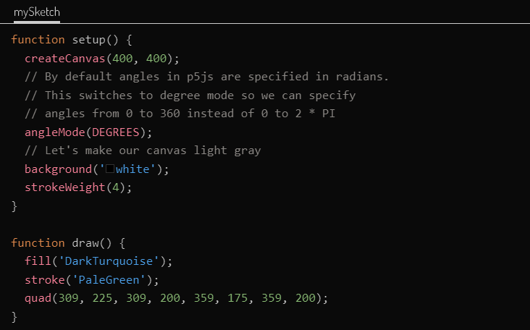

Fills and Strokes
P5js includes many different built in functions for drawing basic shapes:
So far, all the shapes we have been drawing have been filled with white and outlined with black (except for point and line which have no area to fill in).
In p5js to change what colour a shape is filled in or outlined with, you use the fill and stroke functions before you call the various shape functions. The colour you specify will be used for all subsequent shapes, until you make another call to fill or stroke.

Slide 12
Thank you

